Slide 1




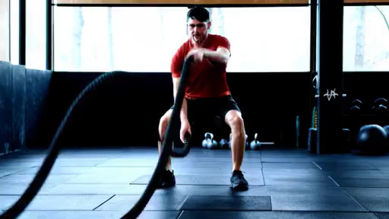

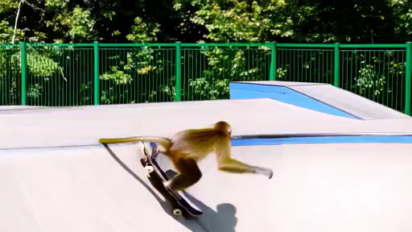
DenseDPO: Fine-Grained Temporal
Preference Optimization for Video Diffusion Models
Ziyi Wu, Anil Kag, Ivan Skorokhodov, Willi Menapace,
Ashkan Mirzaei, Igor Gilitschenski, Sergey Tulyakov, Aliaksandr Siarohin
NeurIPS 2025 Spotlight
Website: snap-research.github.io/DenseDPO/
Notes:
Today I’ll present our recent work DenseDPO, which is published at NeurIPS 2025 as a Spotlight presentation. This work was done during my internship at Snap research with these amazing collaborators. In this work, we propose a diffusion post-training method that enables us to generate videos from challenging text prompts.

Slide 2
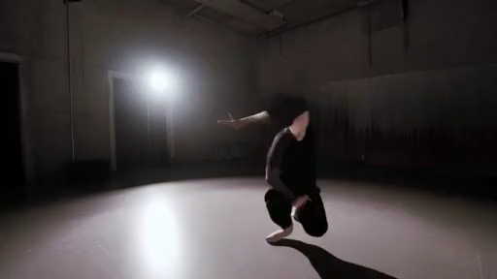
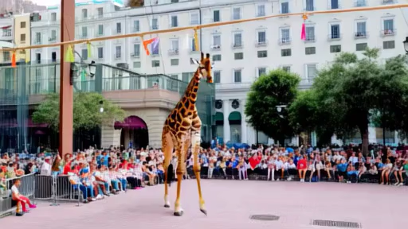
Motivation
Limitations of existing text-to-video generators:
Complex object motion
Novel concept composition
SFT does not help. How to fix this?
Prompt: “A woman doing pop dance”
Prompt: “A giraffe walks along tightrope”
Notes:
Since the release of Sora around 2 year ago, we have seen tremendous progress in video generators. They are pre-trained on large-scale text-video datasets and can produce impressive results.
However, they still struggle with generating complex motions like this woman doing pop dancing, you see a lot of weird deformation of the human body; and they often fail to compose novel concepts like here we want to generate a giraffe walking along a tightrope, it generates both objects, but the giraffe is not really walking on the tightrope
One potential fix is collecting a lot of videos with challenging prompts and fine-tune on it, which is called supervised fine-tuning, SFT. However, recent studies show that SFT can improve visual quality of the video, but has limited benefit on the motion and the text following. So, how can we further solve these issues

Slide 3
Background: Post-Training
Post-training is key to the success of recent LLMs
GPT o1, DeepSeek-R1
Core idea: align a pre-trained model with explicit feedback
Human preference (RLHF)
Verifiable feedback e.g. math, code (RLVR)
Notes:
Inspired by the recent success of LLMs, we turn our attention to the so-called post-training process, which has led to powerful reasoning models like GPT o1 and DeepSeek-R1. Compared to pre-training that uses next-token prediction or denoising loss, post-training explicitly aligns the model output with some external feedback signal. This can be human preference I like this response better than that one, which is called RLHF; or, it can be verifiable feedback like for coding problems you can just run the test cases to get its correctness, this is called RLVR

Slide 4
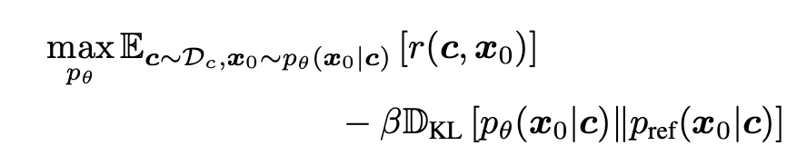
Background: Post-Training
Post-training is key to the success of recent LLMs
GPT o1, DeepSeek-R1
Core idea: align a pre-trained model with explicit feedback
Maximize reward + KL regularization
conditioning, e.g., text prompt
model output, e.g., video
reference model (pre-trained)
Notes:
Concretely, well, don’t worry, this is the only math in this talk, and I won’t go into details. So, post-training often involves a reward function r, which takes in the conditioning and the model output, and tells us how good is this result, like the visual quality and text alignment of a generated video. To prevent trivial solutions, we also have a regularization term that minimizes the KL divergence between the current model and a reference model, often the pre-trained checkpoint we start with

Slide 5
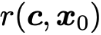
Background: Post-Training
How?
Reinforcement Learning (RL)
Unstable
Hard to obtain an accurate reward model
Notes:
Now the question is how to optimize this objective? Can we use gradient descent? There are 2 issues, one, the reward function may not be differentiable; second, we know that diffusion models usually sample 50 steps to get the result x_0, backpropagating requires unrolling all the intermediate steps which is super expensive. Another way is to use RL. But RL is famous for being unstable and sensitive to the reward. It’s very hard to get an accurate reward model given arbitrary generation

Slide 6

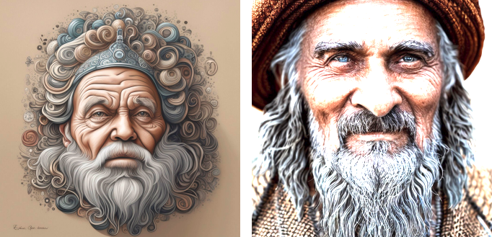


Background: Post-Training
How?
Reinforcement Learning (RL)
Direct Preference Optimization (DPO)
Only need preference pairs:
Prompt: “a wise old man”
[1] DPO: https://arxiv.org/abs/2305.18290
[2] Pick-a-Pic: https://arxiv.org/abs/2305.01569
Notes:
In this work, we turn to another popular post-training framework called Direct Preference Optimization, DPO. DPO gets rid of the explicit reward model, and only requires preference pairs. So you take a text prompt, let the model generate 2 images, and ask a human to label which one looks better. Here, the first image looks more photorealistic thus is considered better

Slide 7
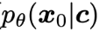
Background: DPO for Diffusion Model
DPO: push up the likelihood of winning data
[1] Diffusion-DPO: https://arxiv.org/pdf/2311.12908
Notes:
DPO objective is quite simple. It encourages the model to generate the winning sample by pushing up its likelihood

Slide 8
Background: DPO for Diffusion Model
DPO: push up the likelihood of winning data, and push down losing data
[1] Diffusion-DPO: https://arxiv.org/pdf/2311.12908
Notes:
And moves the model away from the losing sample by pushing down its likelihood

Slide 9
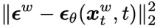
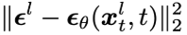
Background: DPO for Diffusion Model
DPO: push up the likelihood of winning data, and push down losing data
Minimize , and maximize
[1] Diffusion-DPO: https://arxiv.org/pdf/2311.12908
Notes:
For diffusion models, we know that the log likelihood is correlated with the denoising loss. So the DPO objective becomes minimizing the denoising loss on the winning sample, while maximizing the one on the losing sample. Very intuitive right

Slide 10
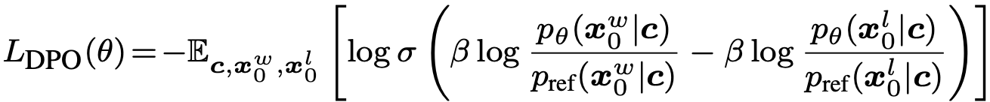
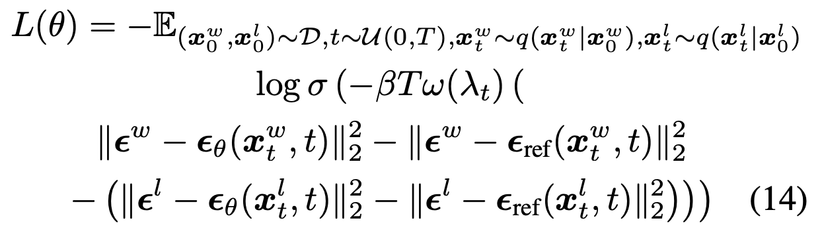
DPO on Diffusion Models (DMs)
In DM, log-likelihood is related to denoising loss (ELBO)
DPO loss → minimize denoising loss on winning data, maximizing losing
Image / video
text

Slide 11
VanillaDPO for Video Diffusion
Prev DPO papers are mostly on image diffusion
Let’s label human preference on video pairs and do video DPO
[1] Diffusion-DPO: https://arxiv.org/pdf/2311.12908
Notes:
Previous diffusion DPO papers are mostly on image generation. Here we directly borrow it to video diffusion

Slide 12


VanillaDPO for Video Diffusion
Prev DPO papers are mostly on image diffusion
Let’s label human preference on video pairs and do video DPO
Prompt: “a woman doing leg exercise on a mat”
[1] Diffusion-DPO: https://arxiv.org/pdf/2311.12908
Notes:
Given a text prompt, we again generate 2 videos, and ask which one is better

Slide 13


VanillaDPO for Video Diffusion
Which one do you prefer?
Prompt: “a woman doing leg exercise on a mat”
Notes:
For ease of comparison, I’m showing some frames here

Slide 14
VanillaDPO for Video Diffusion
Which one do you prefer?
Video 1 has high visual quality. Video 2 is oversaturated + has artifacts
Prompt: “a woman doing leg exercise on a mat”
Notes:
If you ask me, my first impression is the second video looks pretty oversaturated, plus some frames have weird limbs. So I’ll prefer the first one as it has better visual quality and looks more stable

Slide 15
Issue with VanillaDPO
The woman is not really doing leg exercise…
Humans are very sensitive to local artifacts than global semantics
Prompt: “a woman doing leg exercise on a mat”
Notes:
However, if you look closer, the first woman is not really doing leg exercise in the text prompt right? We have seen many such cases in the human annotations we got, where labelers pay more attention to the local artifacts rather than global text alignment

Slide 16
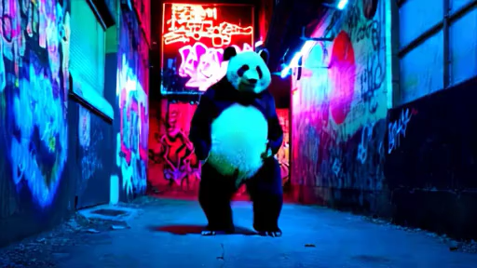
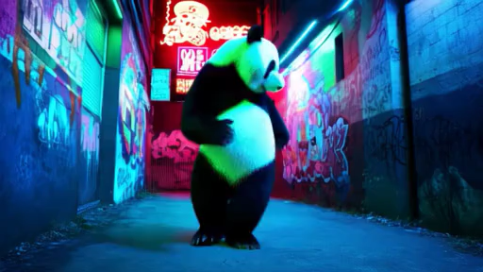
Motion Bias in VanillaDPO
Human preference on videos are multi-dimensional
Some may be inversely correlated, e.g., dynamics vs motion smoothness
Prompt: “a panda breakdancing in a neon-lit urban alley”
Notes:
The root cause is that video quality depends on many factors, such as Visual Quality, Text Alignment, Temporal Consistency, and Dynamic Degree. What‘s worse, these factors can conflict. For example, current video models are good at generating high-quality, but slow-motion videos, like this panda moves around; but if the text prompt requires large dynamics like breakdancing, you often get some distortions, as shown on the right

Slide 17
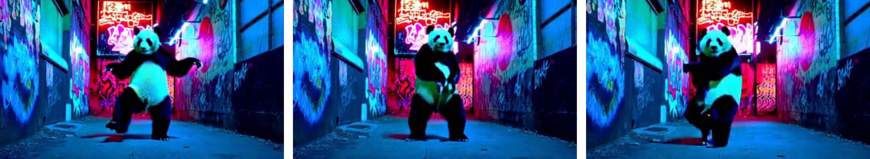
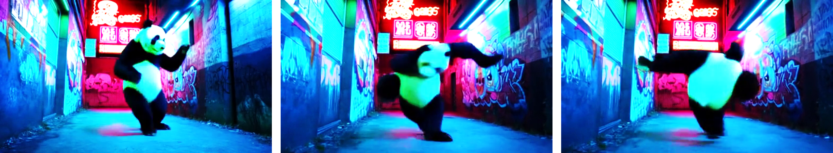
Motion Bias in VanillaDPO
Dynamic videos usually contain visible artifacts
Human labelers prefer artifact-free slow-motion videos
DPO on clean slow-motion videos further suppresses motion generation
Notes:
Now, if you asks me to label preference, I hate artifacts, so I will select this slow-motion video as winning. We call this the motion bias. As a result, the preference data is dominated by these clean but static videos as winning samples, and if you train DPO on it, the model is reinforced to generate increasingly more static videos

Slide 18
StructuralDPO: Removing Motion Bias
Core idea: make 2 videos have a similar amount of motion
How? Guided video generation
VanillaDPO: sample videos from pure noise
StructuralDPO: sample videos from partially noised GT video
Notes:
To solve this motion bias, we propose StructuralDPO. The idea is simple, if motion and visual quality are conflicting, why don't we fix the motion of both videos, and only compare visual quality? In vanilla DPO, we sample 2 videos from purely random noise. In contrast, in StructuralDPO, we use guided generation from partially noised videos

Slide 19
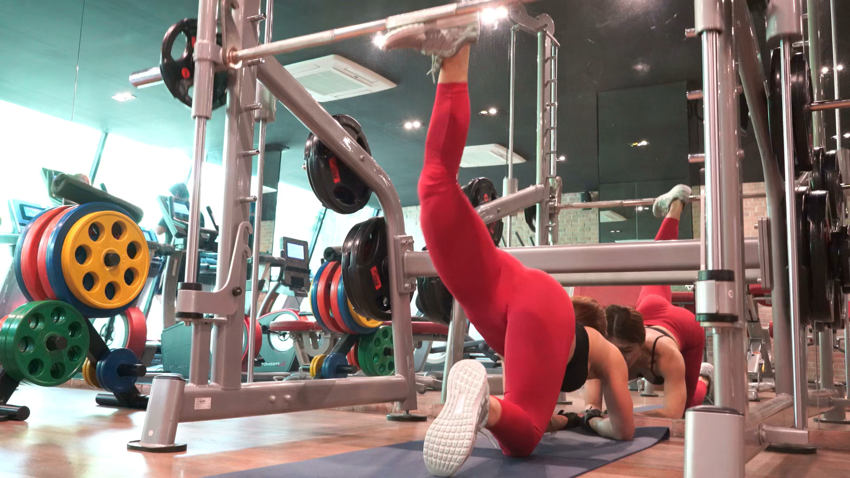
StructuralDPO: Guided Video Generation
Add 2 diff partial noises then denoise
Notes:
Concretely, we take a GT video corresponding to the text prompt

Slide 20

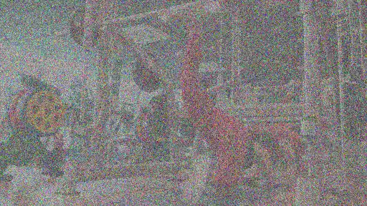
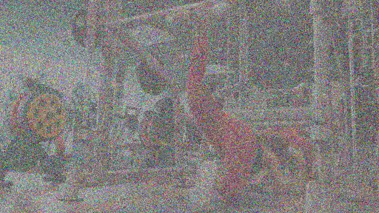
StructuralDPO: Guided Video Generation
Add 2 diff partial noises then denoise
Notes:
add different partial noise to it

Slide 21
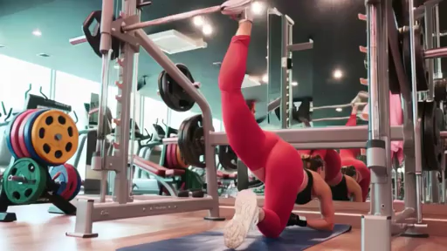
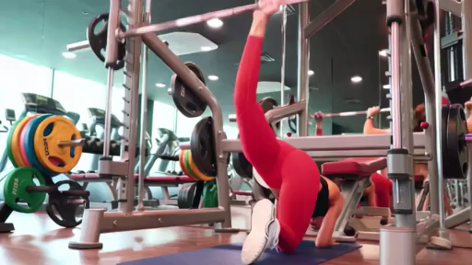
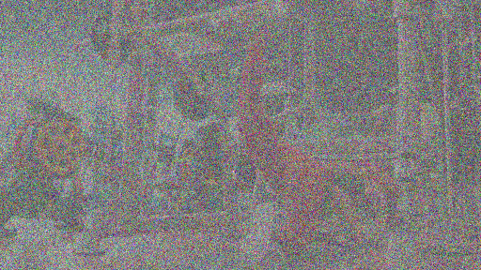
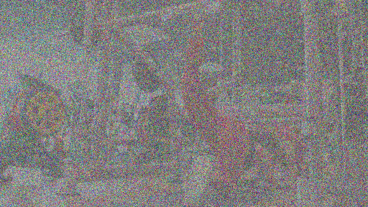
StructuralDPO: Guided Video Generation
Add 2 diff partial noises then denoise
Notes:
and then denoise

Slide 22
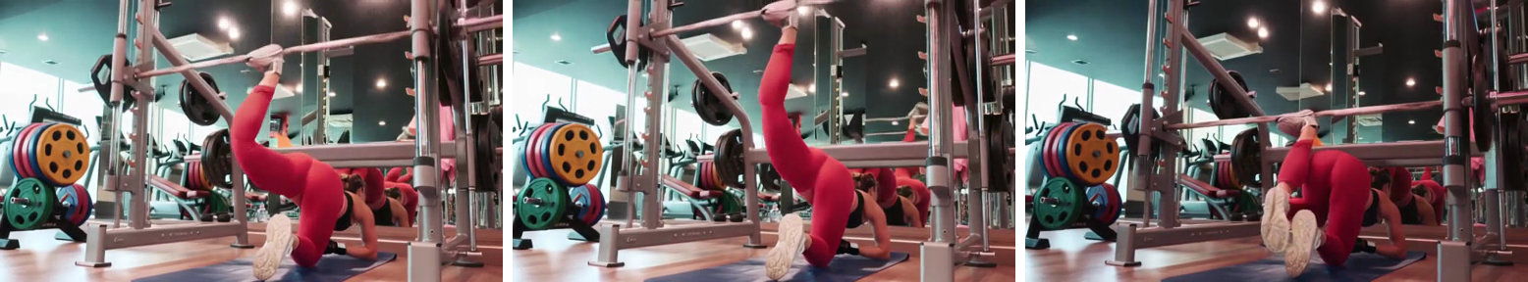
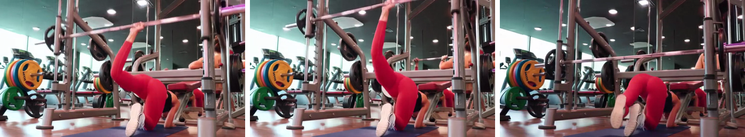
StructuralDPO: Guided Video Generation
Early denoising steps determine structure – similar global motion
Notes:
We know that early denoising steps determine the global structure of the result, so this produces two videos that share the same underlying motion

Slide 23
StructuralDPO: Guided Video Generation
Early denoising steps determine structure – similar global motion
Later steps determine local details – still variations between 2 videos
Notes:
But differ in local details. In this example, in the first half video2 generates a hand instead of a foot, and at the end, video1 produces some artifacts around the leg. With such structurally similar videos, the model can ignore motion difference and only focus on fixing these local artifacts

Slide 24
Issue with StructuralDPO
Which video do you prefer?
Video 1 has fewer artifacts than video 2. So 1 is better than 2
Notes:
So, which video is better? You may say ok video 1 has artifacts on one frame, while video 2 has 2 frames, so video 1 is better.

Slide 25
Issue with StructuralDPO
Which video do you prefer?
Video 1 has fewer artifacts than video 2. So 1 is better than 2
Wait, we still minimize loss on frames with artifacts!
Notes:
And we just apply the DPO loss on it. Looks good? Well, there is one issue here – if we know video 1 also has artifacts here, why do we still optimize it? Indeed, it’s common that both videos have artifacts at different timestamps. If you use a single win/lose label for the whole video, you will reward artifacts somewhere in the video, which is bad

Slide 26
DenseDPO: Richer Temporal Feedback
Instead of global preference labels, we use segment-level preferences
Notes:
So we further introduce DenseDPO that replaces global preference label with dense segment-level label

Slide 27
DenseDPO: Richer Temporal Feedback
Instead of global preference labels, we use segment-level preferences
Densely label each short segment, e.g., every 1s
Notes:
Concretely, we label preference on each chunk of video frames, like every 1s clip

Slide 28
DenseDPO: Richer Temporal Feedback
Instead of global preference labels, we use segment-level preferences
Densely label each short segment, e.g., every 1s
Optimize each segment separately
Notes:
And then we apply DPO loss independently on each segment. This way, winning data are less likely to contain artifacts, and the model gets cleaner training signals

Slide 29
DenseDPO: Discussions
Dense preference requires guided sampling
Structurally similar videos have 1-1 correspondence between segments
Dense annotation has better data efficiency
Global preference: ~2/3 are ties
Dense preference: ~80% video pairs have at least 1 non-tie segment
Notes:
Before proceeding to the experiments, I’d like to make a few remarks. First, dense preference annotation is only possible when using guided sampling to generate video pairs. This is because structurally similar videos have 1-1 correspondence between local segments. In contrast, if both videos contain completely different motions, it doesn’t make much sense to compare them locally
Second, dense annotation leads to much better data efficiency. In DPO, generating pairs of videos is time-consuming. Yet, when labeling global preference, around 2/3 of pairs will be labeled as tie, which cannot be used in training. In contrast, when labeling dense preference, over 80% of pairs have at least 1 non-tie segment, so they can all be used for training. In addition, since we start from partially noised videos, we only need to denoise for fewer steps, which also speed up data collection

Slide 30
More results:
Experimental Setup
Base model: Snap’s internal video model (DiT)
Data construction:
Select 30k high visual & motion quality text-video pairs
Baselines:
SFT: fine-tunes the base model on the 30k videos
VanillaDPO, StructuralDPO: generate 30k video pairs, label global preference
DenseDPO: take 10k video pairs, label dense preference
Dense labeling costs ~3x time compared to global labeling
All trained with LoRA for 1k steps
Notes:
OK now let’s look at experiments. We experiment with Snap’s internal text-to-video model based on the DiT arch. We curate a subset of 30k text-video pairs with good visual quality and large amount of motion. We have 3 main baselines: SFT fine-tunes the base model on the 30k subset. VanillaDPO and StructuralDPO both generate 30k video pairs, and label global preference
For our DenseDPO, since dense preference labeling is around 3x more time-consuming than global, for fair comparison, we only generate 10k video pairs, and label preference for every 1s segment. All these methods use LoRA fine-tuning for 1k steps. I’ll show a few results next, more on our project page

Slide 31
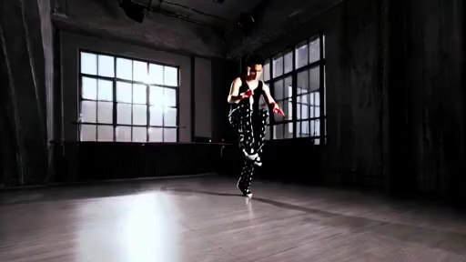
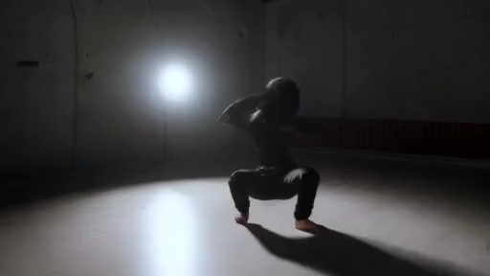
Base Model
Compare with Baselines
Base & SFT: deformed limbs
VanillaDPO: no deformation but slow motion
Prompt: “a woman doing pop dance”
VanillaDPO
SFT
Notes:
I’ll first show a qualitative comparison. Here, the prompt is “a woman doing pop dance in a studio”. Pre-trained model generates a lot of distortions, and SFT cannot fix them. VanillaDPO removes the distortion, but the generated video is static, the person doesn't move much

Slide 32
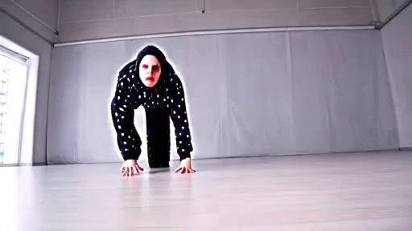
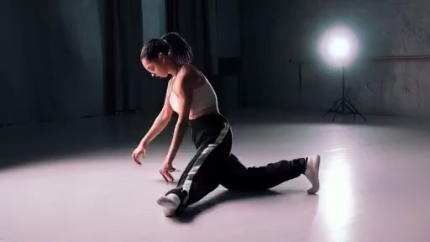
StructuralDPO
Compare with Baselines
VanillaDPO: slow motion
StructuralDPO: preserves motion, but low visual quality
Prompt: “a woman doing pop dance”
VanillaDPO
DenseDPO
Notes:
With StructuralDPO, you fix the motion bias but sometimes degrades visual quality. In contrast, DenseDPO achieves the best of both worlds: we eliminate temporal artifacts with correct physics, and still retain large motion

Slide 33
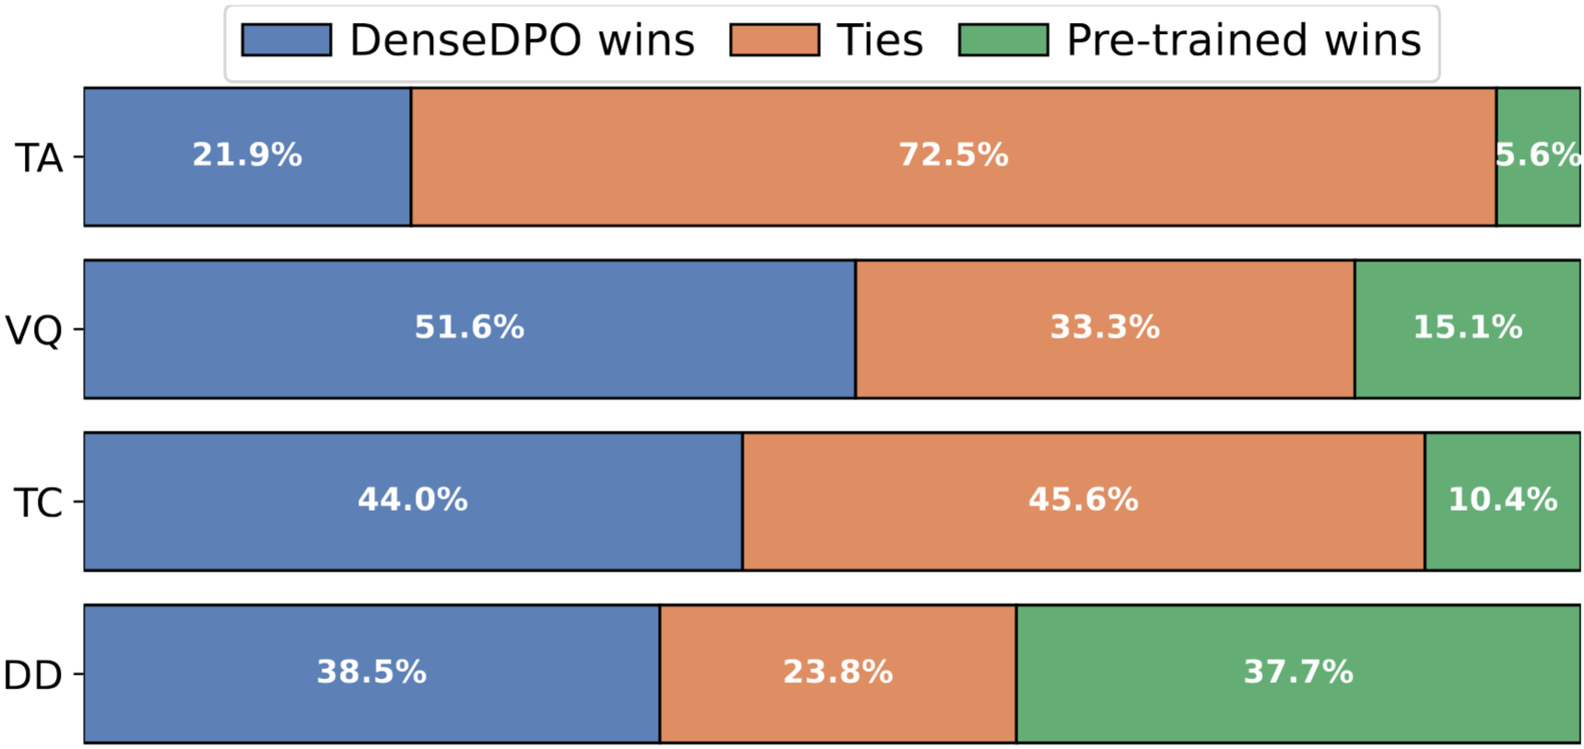
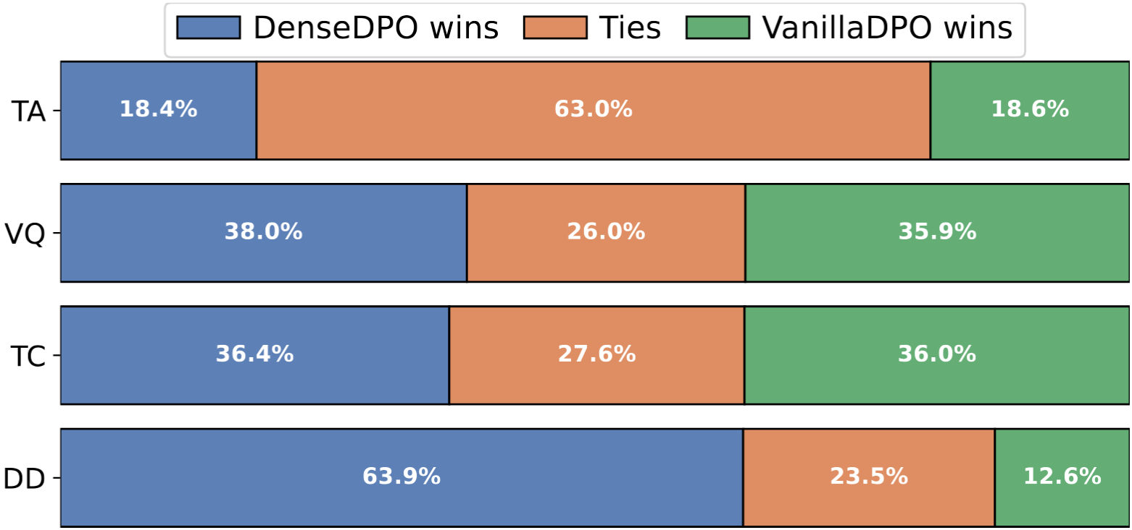
Compare with Baselines
User study results
DenseDPO improves all dimensions over base model
DenseDPO significantly improves dynamics over VanillaDPO
DenseDPO vs Pre-trained
DenseDPO vs VanillaDPO
Notes:
Quantitatively, we perform user study on 500 prompts. Compared to pre-trained model, DenseDPO improves text alignment (TA), visual quality (VQ), temporal consistency (TC), and retains similar dynamic degree (DD)
Compared to VanillaDPO, we are close in other dimensions, but significantly improves the dynamics, which aligns with the qualitative results

Slide 34
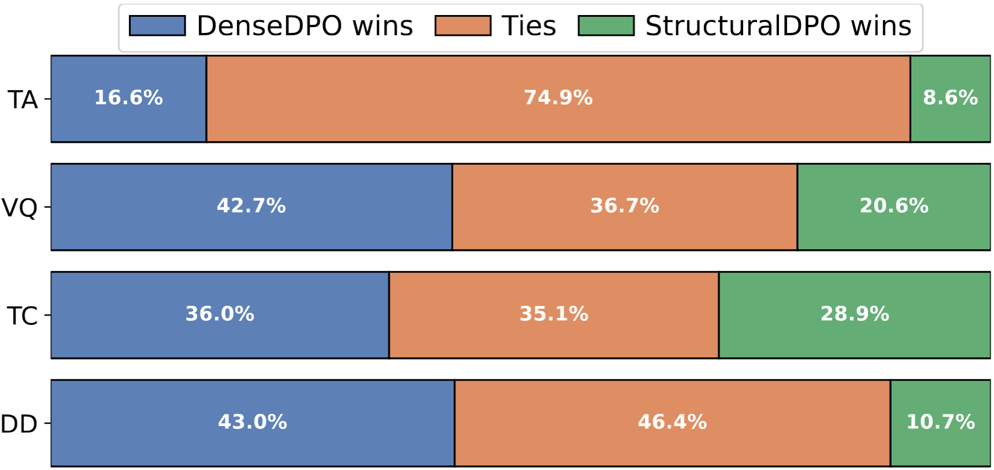
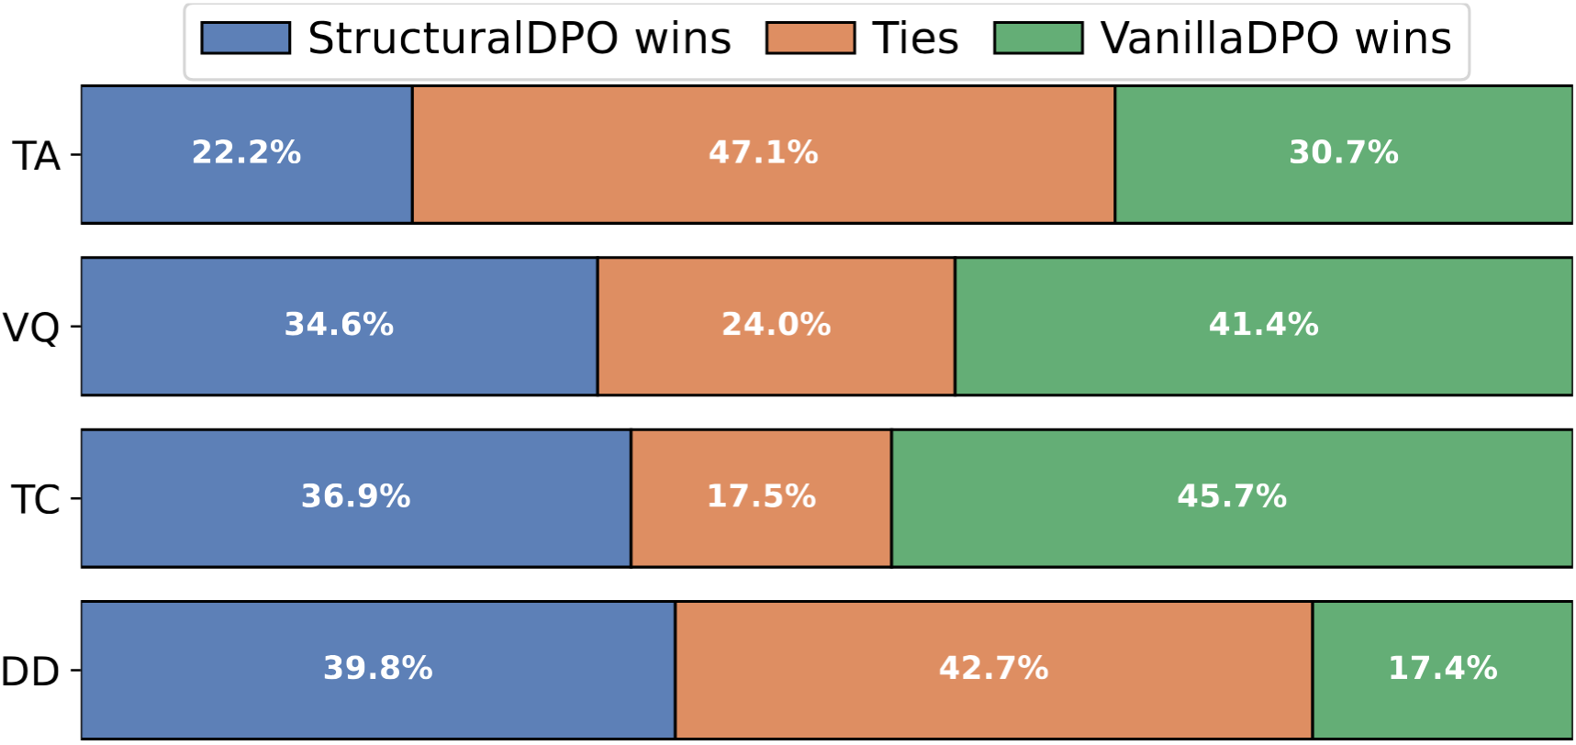
Compare with Baselines
User study results
DenseDPO improves all dimensions over StructuralDPO
StructuralDPO improves dynamics but degrades other dimensions
DenseDPO vs StructuralDPO
StructuralDPO vs VanillaDPO

Slide 35
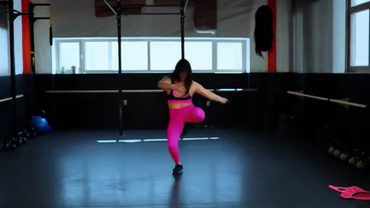
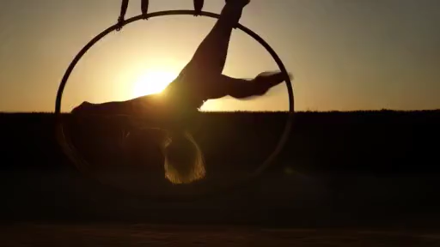
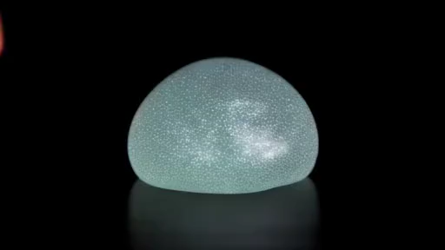
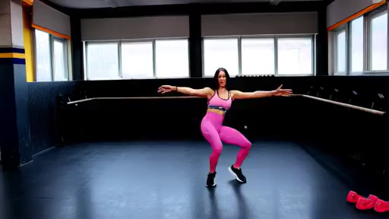

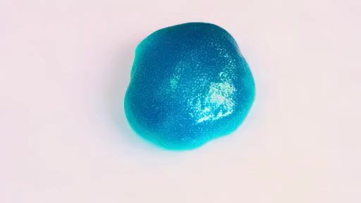
Complex Object Motion Results
“Dance and spin”
“Transition on aerial hoop”
“Fingers press slime ball”
Base
DenseDPO
Notes:
Here are more qualitative results. I mentioned earlier that two limitations of existing video models are complex motion and novel concept composition. Here are some challenging motion generated before and after DenseDPO fine-tuning

Slide 36
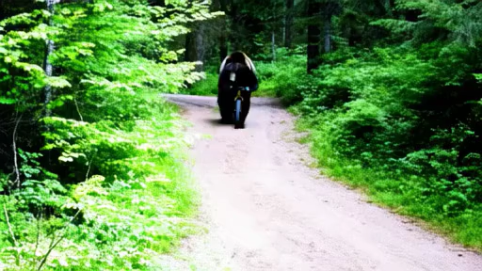
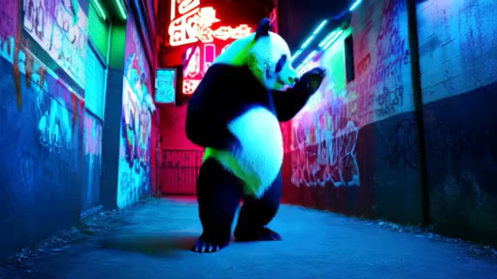
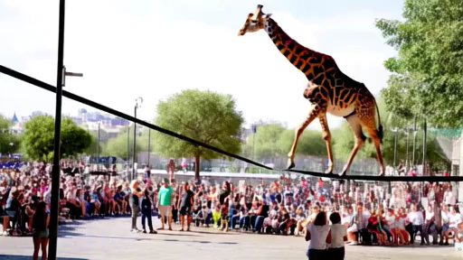
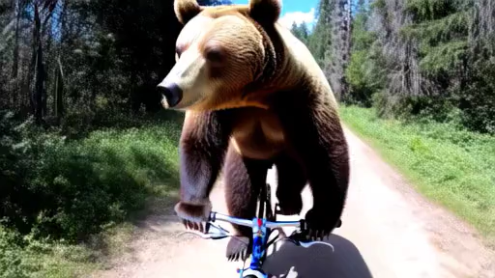
Novel Concept Composition Results
“Panda breakdance”
“Giraffe walks over tightrope”
“Bear biking”
Base
DenseDPO
Notes:
Here are some novel concepts like panda dancing, giraffe walks over tightrope, and bear biking

Slide 37
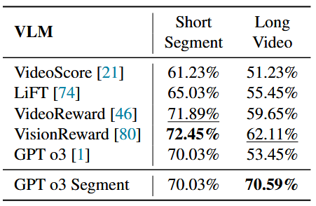
DPO with VLM Labels
Can we automate preference annotation with VLMs?
5s videos: even SOTA video reward models struggle
1s segments: significantly better results, even zero-shot GPT o3
Notes:
So far, I have shown results with human annotations. But human label is always expensive. We thus explore whether we can replace human annotators with VLMs. Like asking GPT which video looks better
In fact, people fine-tune VLMs on video preference data to create video reward models, aiming to automate preference annotation. However, we found that even SOTA models struggle with comparing full 5s videos. They only got ~60% agreement with human labels. In contrast, when we ask them to compare short 1s segments, even GPT o3 that is never trained for such task, reaches ~70% zero-shot accuracy. This means our proposed segment-level preference is not just better for DPO, it also makes preference annotation much easier for VLMs

Slide 38
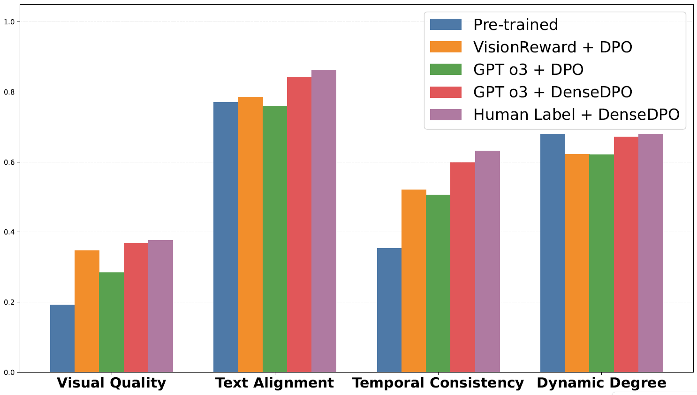
DPO with VLM Labels
Can we automate preference annotation with VLMs?
DenseDPO + GPT labels reaches performance close to human labels!
Notes:
Running DenseDPO on GPT-generated labels, we reach performance close to using human labels. This suggests a promising direction to scale up automatic preference annotation on videos

Slide 39
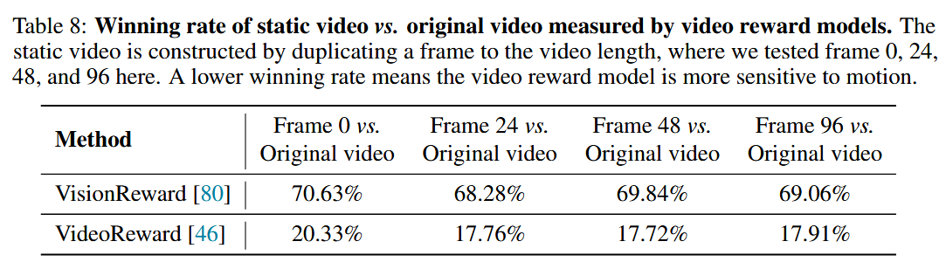
DPO with VLM Labels
Why are VLMs bad at long 5s videos?
They are not fine-grained enough to localize the small local artifacts
They are insensitive to the temporal order of videos

Slide 40
Takeaways & Future Directions
Videos are different from images due to its temporal dimension
We really need fine-grained supervision to improve video generation
Spatial condition: VideoJAM’s optical flow
Temporal condition: MinT’s dense temporal caption
Human feedback: more detailed, e.g., frame + patch level?
How to improve VLM’s preference labeling quality?
Recent papers [1,2] show that video LLMs are not sensitive to temporal order of video frames
We need better pre-training! E.g., native multi-modal training
[1] Breaking Down Video LLM Benchmarks: https://arxiv.org/abs/2505.14321
[2] Enhancing Temporal Understanding in Video-LLMs: https://arxiv.org/abs/2510.26027
Notes:
OK a few takeaways from the project: compared to images, videos are really different due to the extra temporal dimension. We really need fine-grained supervision, or grounding, to improve video generation. For example, VideoJAM has shown that you can use optical flow to improve low-level temporal motion; my prev work MinT also shows that with dense captions over time, you get better dynamics and storytelling. Built upon DenseDPO, can we go beyond temporal preference to use even more fine-grained preference? Like spatial-wise, label if a patch contains artifacts or not
Orthogonal to this, I’m also interested in improving automatic preference labeling. Recent papers show that video LLMs may be insensitive to temporal order of frames. I once did an experiment where I take a video, split it into several 1s segments, and shuffle the frames within each segment. I then send the video to GPT and ask if the video looks weird, over 90% of time GPT says no it looks all good. This seems to suggest that video LLMs are more like bag-of-frames. They understand global semantic of videos but cannot process local details. Yet these local details are important for detecting artifacts. This may stem from the pre-training mechanism of these models, and to solve it we need better pre-training paradigm, like the recently popular native multi-modal pre-training.

Slide 41
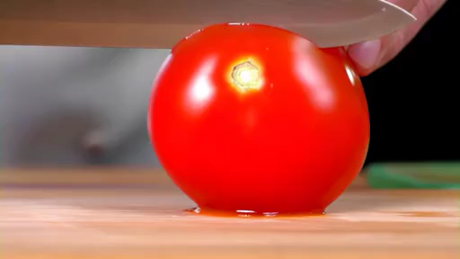

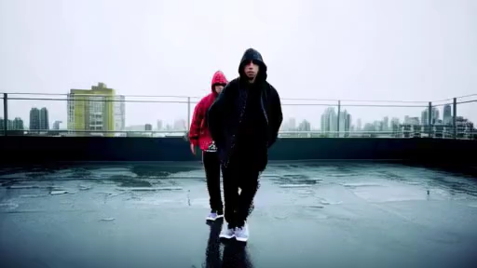
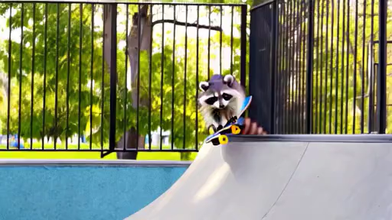
Thank You!
More results on our project page:
snap-research.github.io/DenseDPO/
Notes:
OK that’s all for my presentation. Thanks for listening! Please check out our project page for more results

